Slide 1
OD Matrix:
NYC Taxi Trip Analysis
2024/06/03
龚覃若萱 李元哲 张弛 胡嘉维

Slide 2
Part one
Background

Slide 3

Question and Objective
In the current era of intelligent transportation, everyone can enjoy the convenience brought by ride-hailing services. The data generated by the platforms present an opportunity for city planners and researchers to analyze and predict travel demand more accurately.
Question
How can we accurately predict Origin-Destination (OD) matrices to optimize urban mobility and improve the efficiency of ride-hailing services?
Objective
Develop more accurate and real-time predictions of travel demand by leveraging vast amounts of taxi trip data, ultimately contributing to smarter and more efficient urban transportation systems.

Slide 4
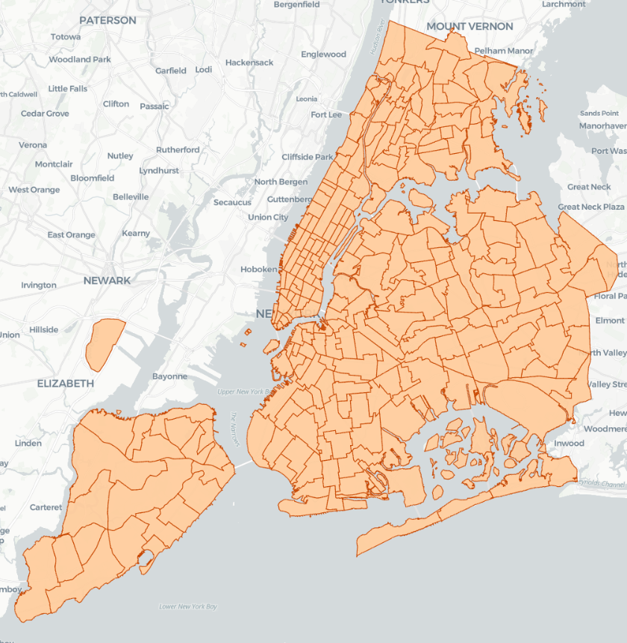
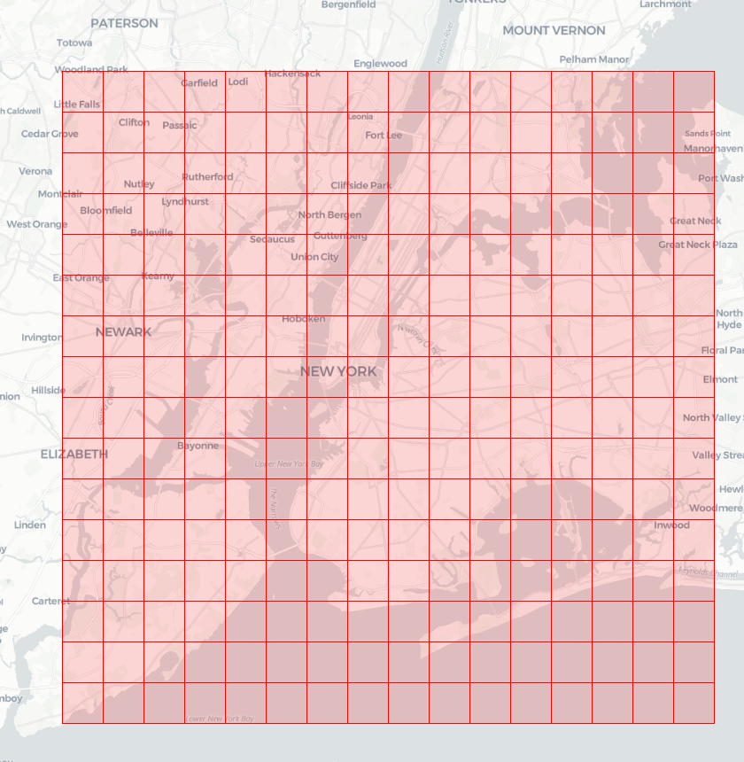
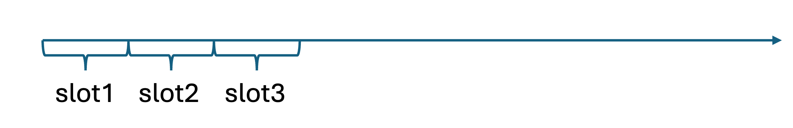
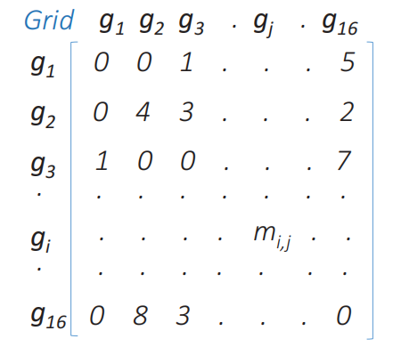
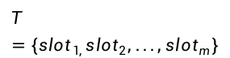
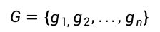
Related Concepts
Grid
n non-overlapping grids
2 types: regular division and irregular devision
$$G=\{g_{1, }g_{2}, ..., g_{n}\}$$
Time slot
evenly partition the time into a sequence of m slots
$$T=\{{slot}_{1, }{slot}_{2}, ..., {slot}_{m}\}$$
Irregular devision Regular division
Origin-Destination (OD) Matrix
square matrix that represents the number of trips or movements between origin grids and destination grids within a specific area or network
OD Matrix Prediction
A regression task. Given a sequence of observed OD matrices M₁, M₂, ... , M_{t} and auxiliary traffic context X_{aux} (optional), to predict the OD Matrix M_{t+1} in the next time slot
OD matrix

Slide 5
Part two
Dataset and Framework

Slide 6
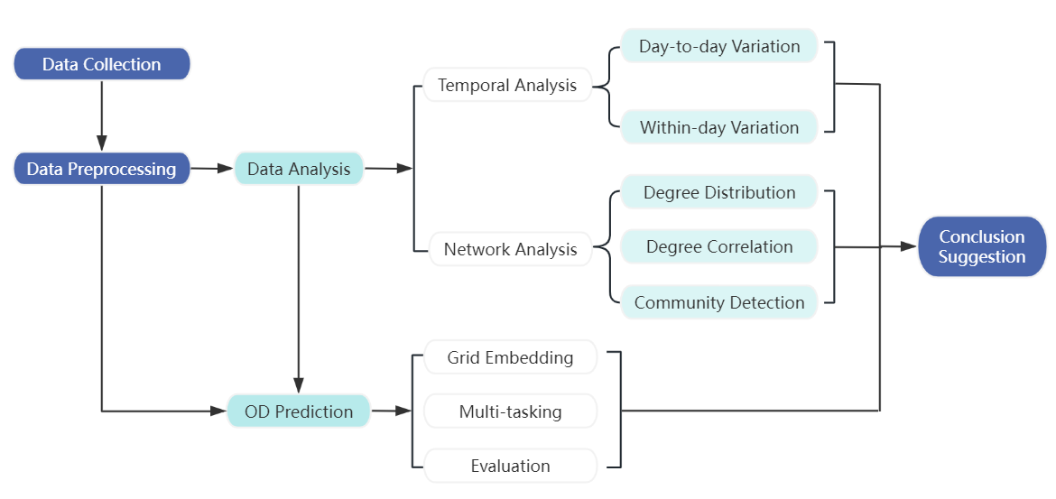
Workflow Structure

Slide 7
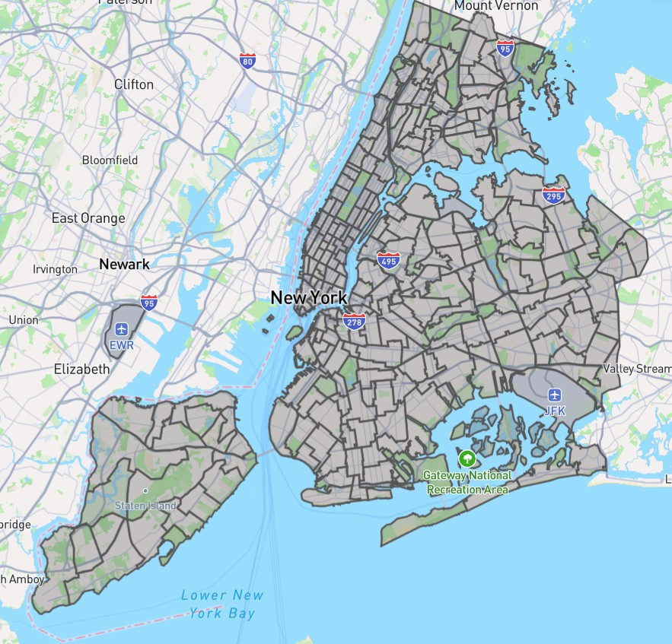
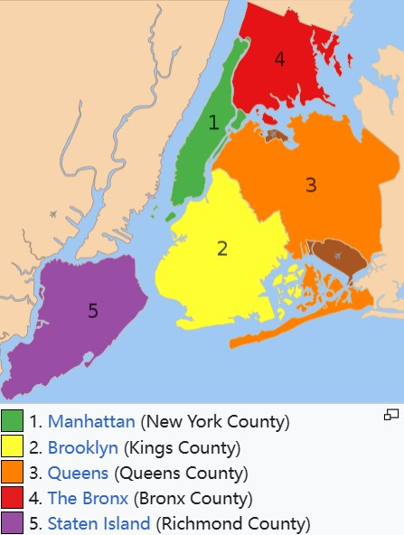

Overview
TLC Trip Records
NYC Taxi Zone NYC Administrative District
City | New York
Longitude range | -74.02-73.95
Latitude range | 40.67-40.77
Time Period‎(UTC-4) | 2023/10/01-2024/3/31
Number of time slot | 4392
Length of time slot | 1 hour
Number of grids | 263×263
NYC Taxi Zones Geojson
The coordinates of the regional boundaries
LibCity Library
https://www.nyc.gov/site/tlc/about/tlc-trip-record-data.page
https://libcity.ai/#/

Slide 8
Data Cleaning and Preprocessing
Geometry File
Store geographic entity information
Geo_id
Type
Coordinates
Sptial Cleaning
Exclude records where the pick-up and drop-off locations were the same.
Relation File
Store Geographical relationships
Origin_id
Destination_id
Cost
Interested Columns
Pick-up and drop-off times, and pick-up and drop-off locations
OD Dynamic FIle
Temporal Cleaning
Store OD matrix at each timeslots
Time
Origin_id, Destination_id
Flow
Convert the times to timestamp format and UTC-4 version. Calculate the minimum and maximum timestamps and segment the data into 1-hour intervals. Retain only the records where the start and end times fell within the same time interval.

Slide 9
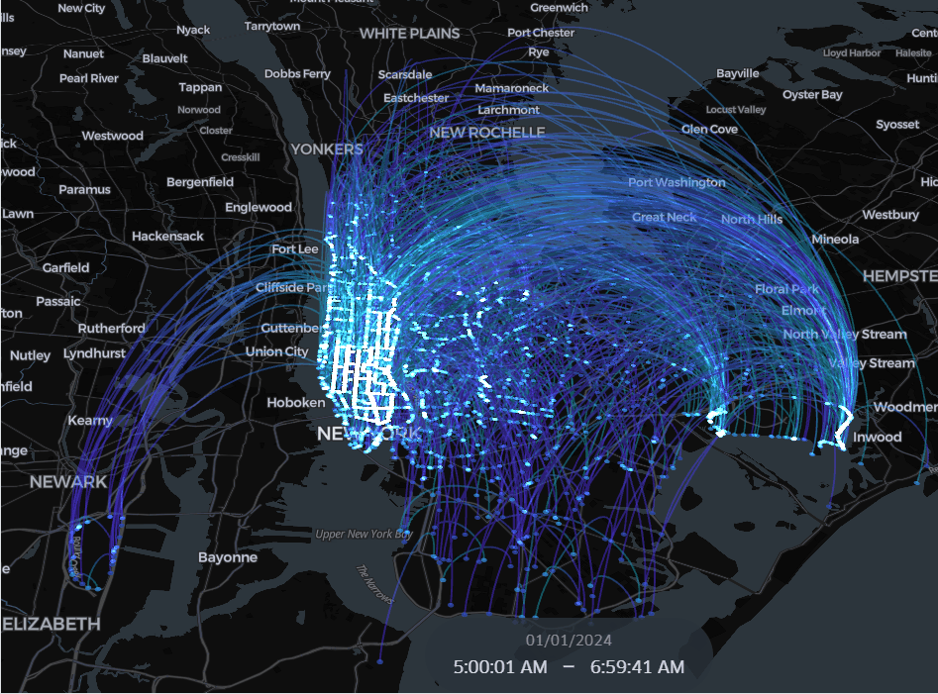
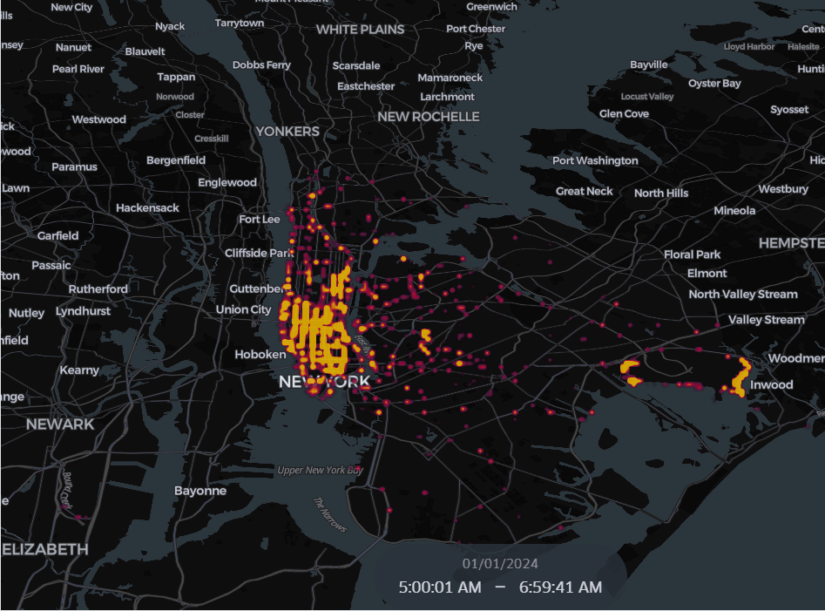
Challenge and Data visualization
Sparsity: Values at 298,476,633 positions in the 4392 263*263 OD matrices are zero
Spatial and temporal feature fusion: Integrate temporal and spatial information for modeling
Prediction in 2 aspects: the quantity of passenger demands from the origin and the final destinations
January 1, 2024
Taxi Trip Flow
Heatmap of Popular Departure Locations

Slide 10
Part three
Data Analysis

Slide 11
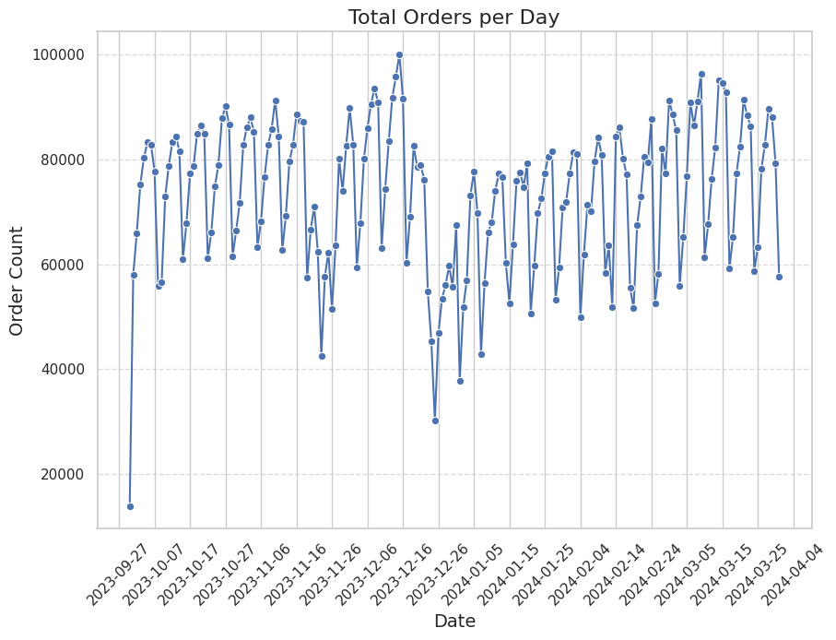
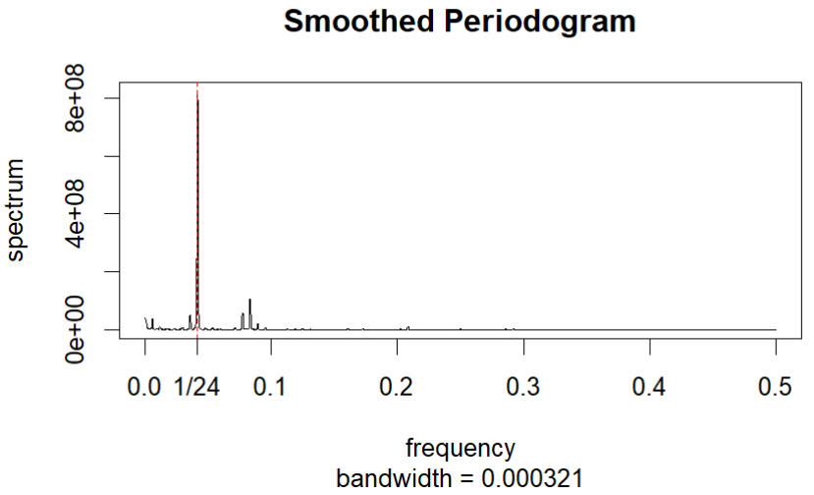
Temporal Analysis
Day-to-day Variation
Within-day Variation
Over the six months, the total number of orders per day fluctuates, with notably fewer orders on Thanksgiving (November 23rd) and Christmas (December 25th).
The order volume follows a 24-hour cycle.

Slide 12
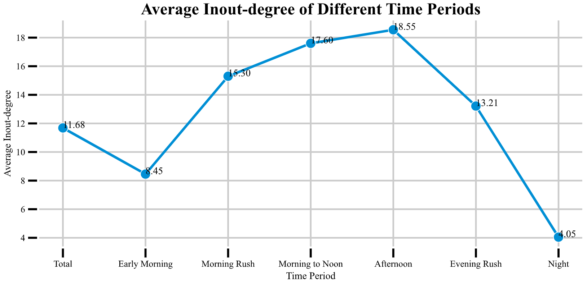
Network Analysis --- Network partition
total/NYCTAXI_OD_Total: For each od pair, flow is averaged, meaning the average flows per hour.
timeperiod/NYCTAXI_OD_xxx: For each time period, taking average of flows of each od pair.
TimeSegment | TimeRange
EarlyMorning | 00:00-06:00
MorningRushHour | 06:00-10:00
Mid-MorningtoNoon | 10:00-12:00
Afternoon | 12:00-16:00
EveningRushHour | 16:00-19:00
Evening/Night | 19:00-24:00
The number of orders is highest in the afternoon and there are fewer orders at night.

Slide 13
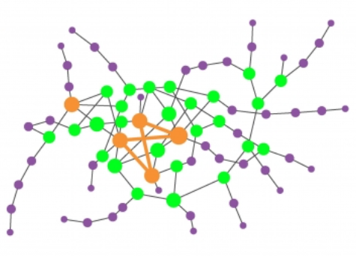
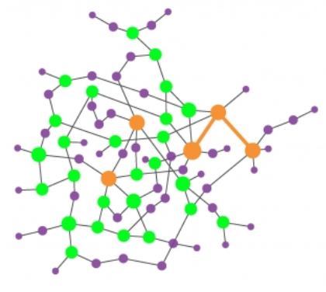
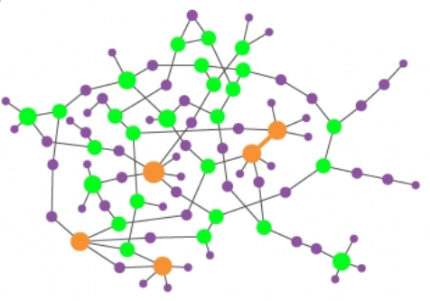
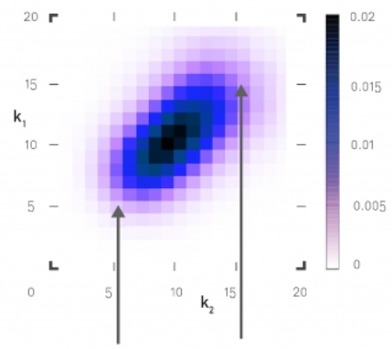
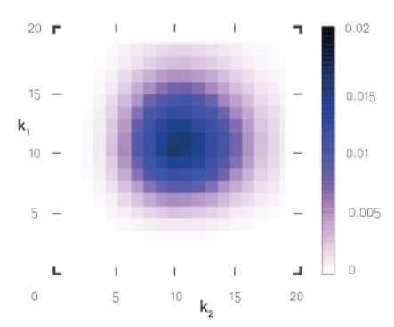
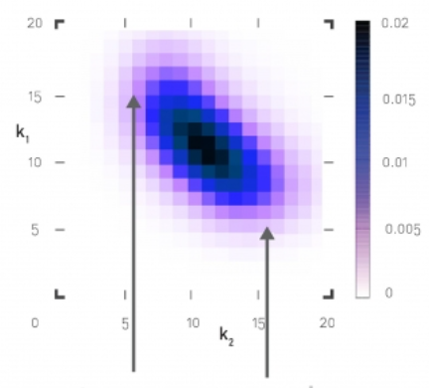
Network Analysis --- Degree Correlation
Degree Correlation: does large hubs tend to link to each other?
Assortative: large hubs link to large hubs.
Neutral: no explicit tendency.
Disassortative: large hubs link to small nodes.
Assortative
Neutral
Disassortative

Slide 14
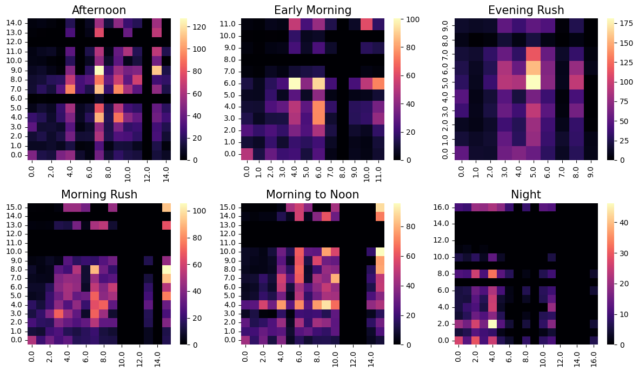
Degree Correlation

Slide 15
Network Analysis --- Degree Correlation
Assortative: large hubs link to large hubs.
Neutral: no explicit tendency.
Disassortative: large hubs link to small nodes.
Not assortative: should not ignore the flow between hubs and fringes
Should not ignore the radial pattern.

Slide 16
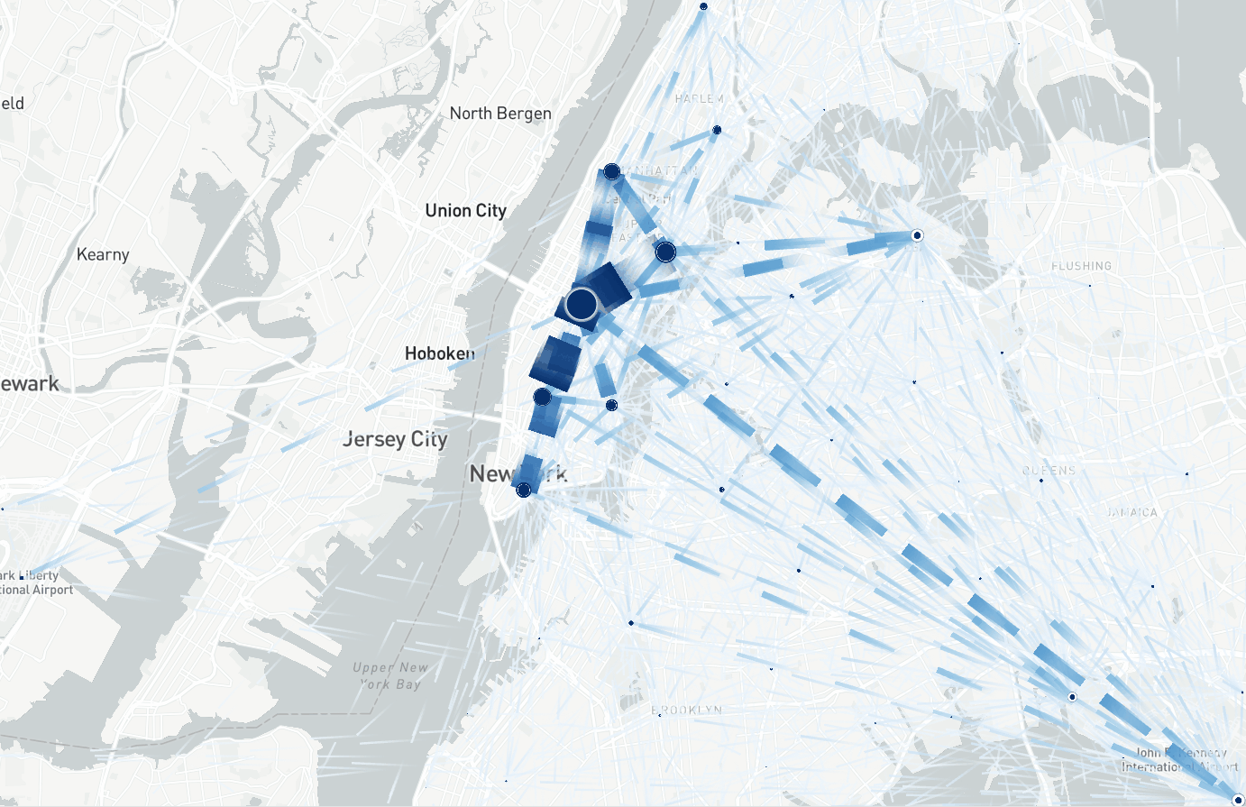
Two types of distance: geographic and semantic.

Slide 17
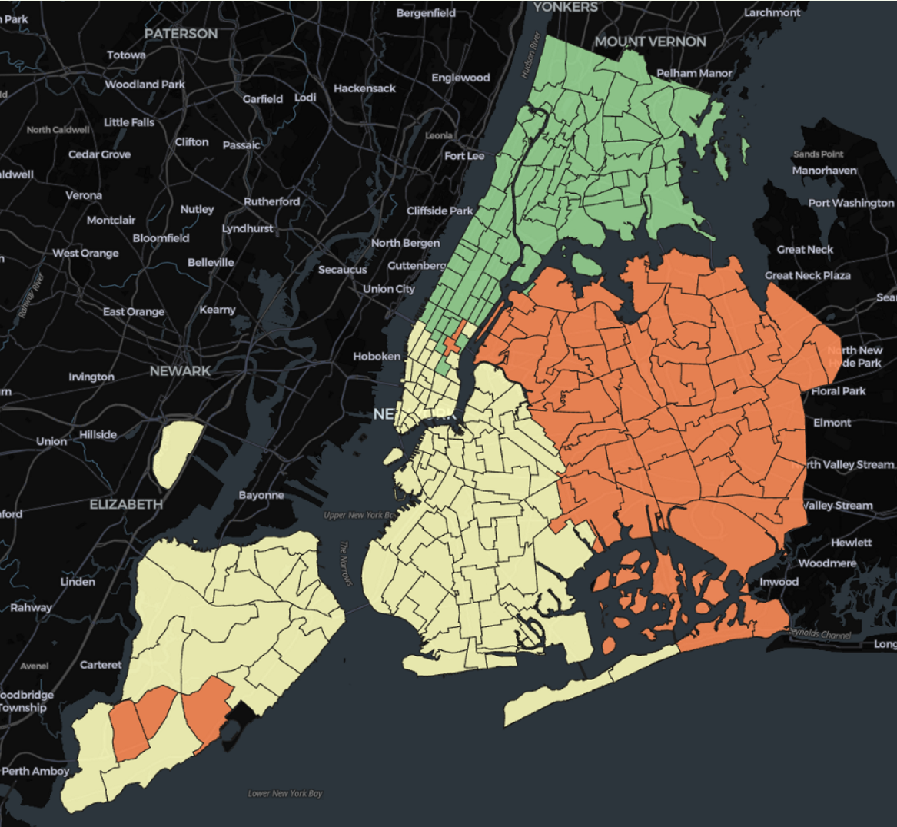
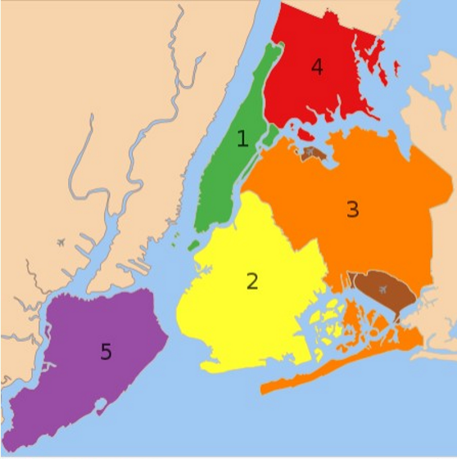
Network Analysis --- Community Detection
Partition detected by Louvain algorithm
Real partition of Administrative district

Slide 18
Part four
Methodology

Slide 19
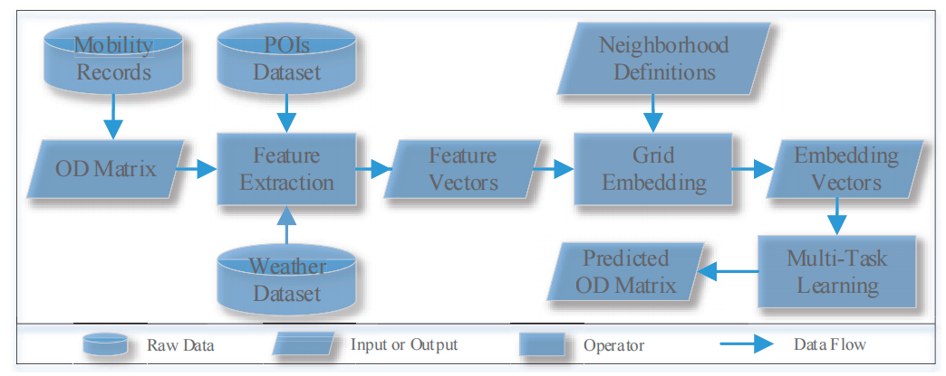
Overview
Grid-Embedding based Multi-task Learning (GEML)
1
2
3

Slide 20
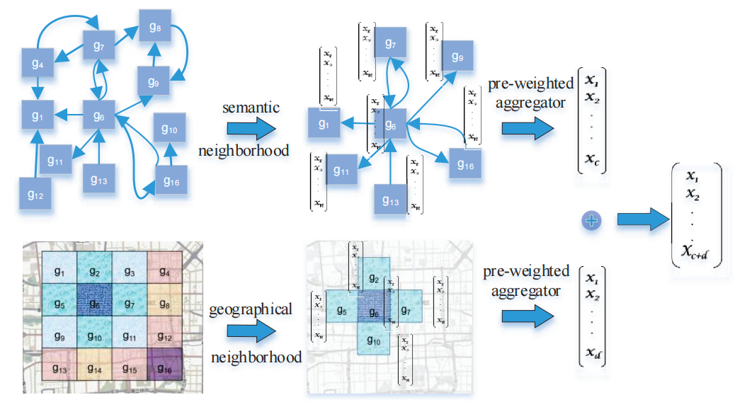
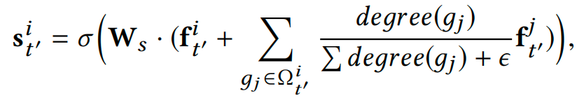
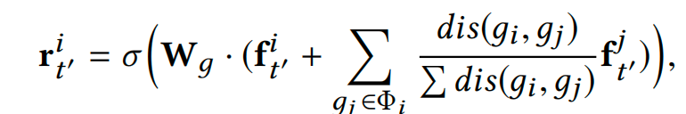
Grid Embedding
Higher Flow, Greater Impact!
Closer, Greater Impact！
is the input OD matrix

Slide 21
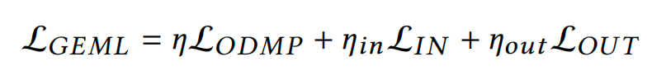
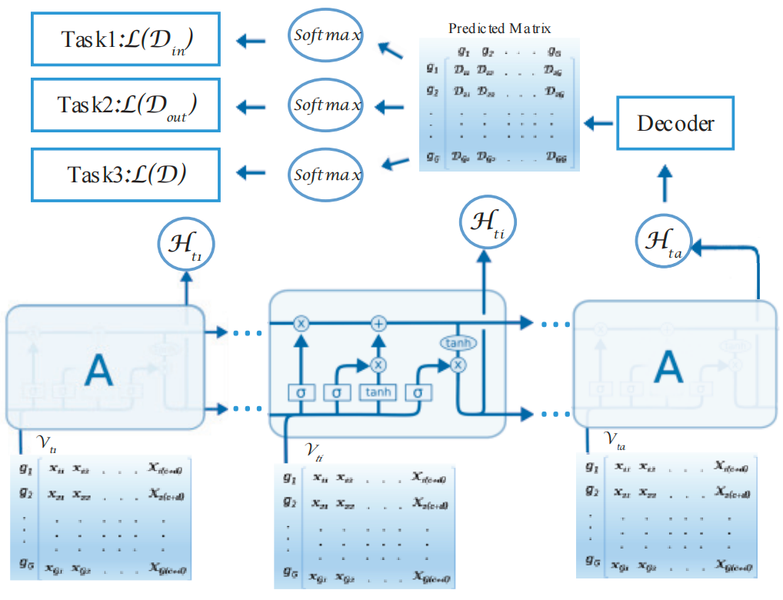
Model and Multi-Tasking
Evaluation | MAE | MSE | RMSE
GEML | 0.055 | 0.222 | 0.471
Trainable Parameters | 691456
Embedding dim | 128
Learning rate | 0.001
Input window | 8
Output window | 1
Input Vector

Slide 22
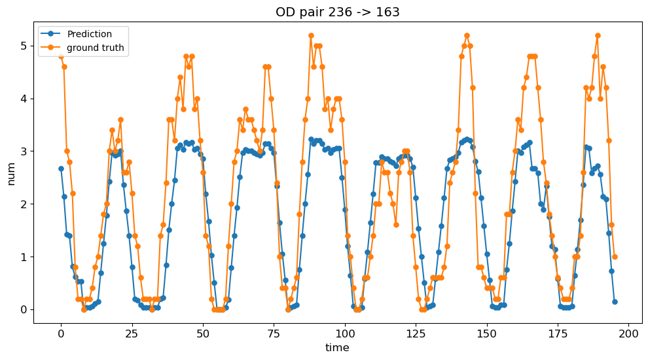
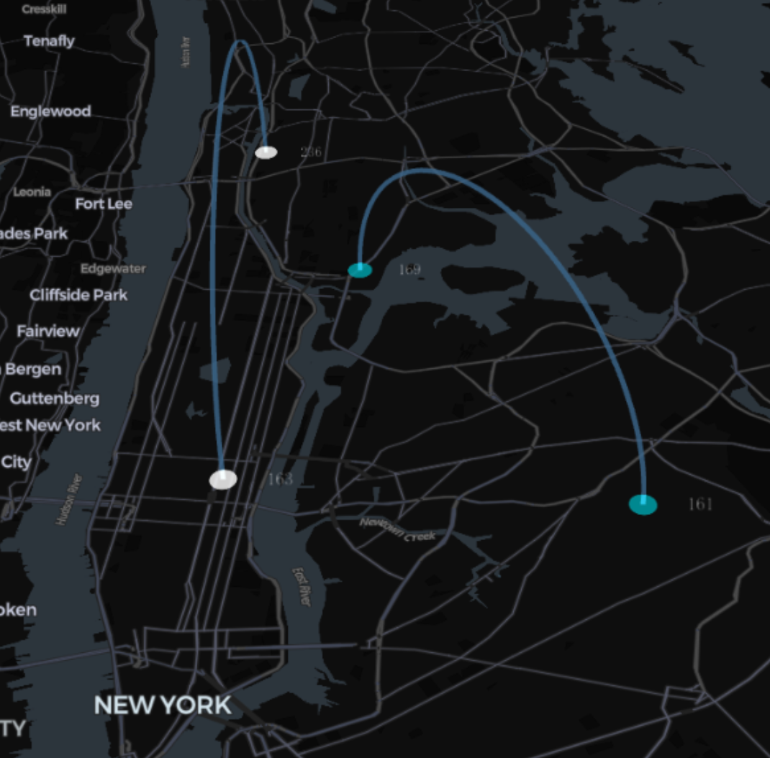
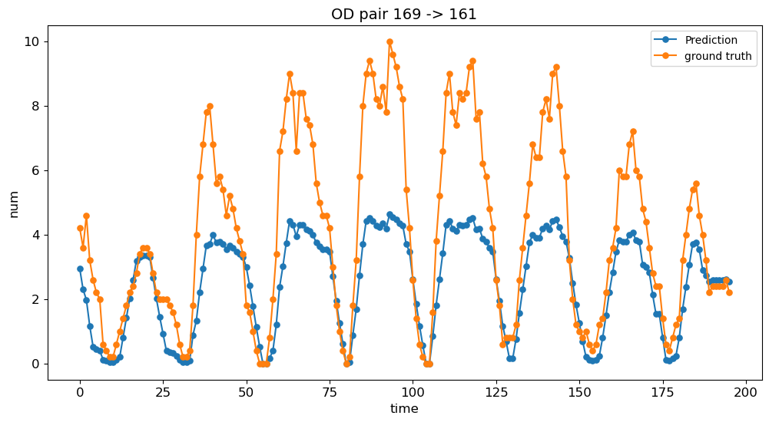
Comparison Experiment
Flow between two regions in 200 hours

Slide 23
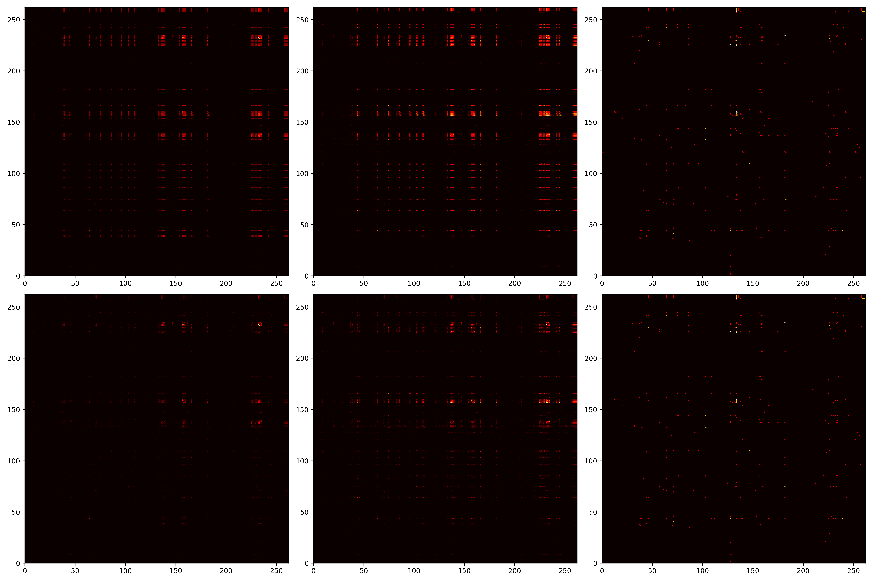
Experiment
22:00
8:00
14:00
Forecast Values
27/3/2024 OD Matrix
True Values

Slide 24
Part five
Conclusion & Suggestion

Slide 25

Conclusion
Order Volume During Holidays: Orders are fewer during holidays within a 24-hour cycle. Plan work schedules to avoid idle time during low-demand periods.
Peak Hours: Orders peak during noon and afternoon. Take breaks during off-peak hours to maximize order volume during peak times
Focus on communities: Avoid stopping at the borders of communities to wait for orders, as orders within communities are denser than those at the borders
Model Development: Use the improved OD matrix prediction model to identify high-demand areas and times for targeted planning.

Slide 26
TNANKS
for your attention

